Slide 1
Privacy and Big Data
15-421/08-731 and 46-869 -- Fall 2013 – Lecture 22
Information Security & Privacy
Norman M. Sadeh
School of Computer Science
Carnegie Mellon University

Slide 2
Outline
Privacy and Big Data
Student Presentation:
“Privacy Preserving Data Mining,” Pranshu and Chao

Slide 3
Data-Centric Society
Data-intensive products and services
The Internet enables companies to collect vast amounts of data by tracking us across multiple websites, across multiple devices, across multiple services
Pervasive computing
Social networking
Data as a traded commodity
Data is key to innovation (e.g. from medical research to smart grids)
Government: Security has become data-centric too

Slide 4
Big Data Aggregators
Google, Facebook, etc
Profiling companies: ChoicePoint, Acxiom, Experian

Slide 5
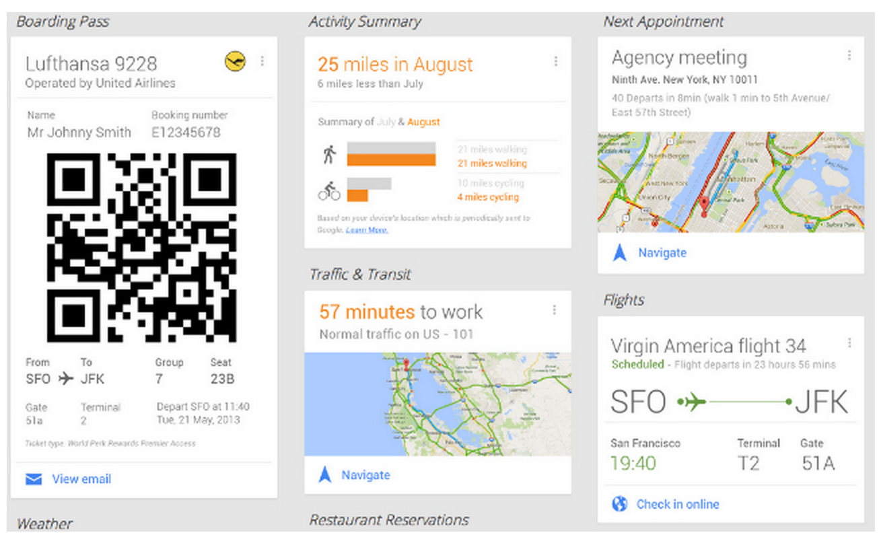
Google Now
http://www.youtube.com/watch?v=pPqliPzHYyc
What does Google Now know about you?

Slide 6
Data Collection Purpose
Fundamental principle of information privacy is that information should be collected for a given purpose
Purpose should be stated
Consent (whether via opt-in or opt-out) is for a particular purpose
Many laws and regulations place limits on frivolous data collection
The aggregation, recombination and mining of data coming from multiple sources challenge these principles/expectations

Slide 7
Inference Control
The Internet and more generally increasingly complex value chains are promoting the exchange of data
Amazon and UPS sharing your address
Mobile apps sharing your data with ad networks and analytics companies
Hospitals releasing medical data for research
How do you share data with 3rd parties while controlling inferences made using the data?
Can you?
Are there tradeoffs?

Slide 8
Inference Control in Medicine as An Example
Standard approach:
Remove patient’s name and address
“De-identification”
Problem: Many complex queries or combinations of queries can potentially be used to re-identify a patient
e.g., query for a politician born on a given date who had a well-publicized accident on another date (e.g. broken collar bone in a football game in a given date), to see if this politician has also been treated for drug problems

Slide 9
HIPAA Privacy Rule
Recognizes “de-identified information” as medical information that “has been propertly de-identified.”
Means:
Either: 18 specific identifiers have bee removed (e.g, name, street address, birth date as well as date of admission and discharge, SSN, photo, etc.) and the DB operator has no knowledge of additional sources of information that can be used to re-identify individuals
Or: a qualified statistician concludes that the risk is substantially limited
Also recognizes “limited data sets”, which contain more data but are subject to contractual restrictions

Slide 10
Anonymizing Data is No Easy Task - I
Tension between protecting data subjects and utility of the data (e.g. for research)
Many medical incidents – US and other countries
AOL incident in 2006: release of supposedly anonymous records of 20 million searches – 3 months 650,000 users
e.g. search queries for a user included medical ailment, landscapers in a given neighborhood, 3 dogs, etc.
Class action lawsuit
Resignation of employees & CTO

Slide 11
Anonymizing Data is No Easy Task - II
2007 Netflix Incident: Published presumably anonymized viewer ratings for 500,000 subscribers and offered $1M prize for better recommendation system
Researchers showed that it was possible to re-identify people using publicly available preferences in the Internet Movie Database (IMD)
Long-tail effect: once you remove the top 100 most popular movies, the remaining movies can be used to uniquely re-identify many users
Violation of Video Privacy Protection Act

Slide 12
Theory of Inference Control
D: Set of statistics disclosed
Query set = set of records returned in response to a given query
P: Set of sensitive statistics – to be protected
P’: complement of P – i.e., non-sensitive
We want D ⊆ P’
If D = P’ then the protection is “precise”
Otherwise there is some degradation in the usefulness of the data being disclosed

Slide 13
Some Available Methods
Query Set Size Control
Can be attacked with “Trackers”
More sophisticated query controls
Cell suppression
Maximum Order Control and Lattice Model
Audit-based Control
Randomization

Slide 14
Query Set Size Control
Specify a minimum query size
e.g. New Zealand’s National Health Information System DBs reject statistical queries whose answers would be based on fewer than 6 patients’ records
Clearly limited in its effectiveness: if one submits succession of queries, it is still possible to isolate a single individual
Accordingly, NZ only allows queries from “cleared medical statisticians”

Slide 15
Trackers
Assume a department has only one female employee
You can find out the female employee’s salary by asking 2 queries:
Average salary of all employees
Average salary of all male employees
A tracker is a custom formula is a custom query that allows someone to infer sensitive data

Slide 16
More Sophisticated Query Controls
Can come up with any number of rules
US census: ‘n-respondent, k% dominance rule”: do not release statistics of which k% or more is contributed by n values or less
e.g. imagine a small village with one extremely wealty individual. Releasing average income would possibly reveal that one individual’s income.

Slide 17
Cell Suppression
Example: UK rules require that it’d be unlikely that any statistical unit, having identified themselves, could use that knowledge, by deduction, to identify other statistical units

Slide 18
Example of Grades
Each entry: Nb. of students with corresponding major and minor
Minor\Major | Biology | Physics | Chemistry | Geology
Biology | - | 16 | 17 | 11
Physics | 7 | - | 32 | 18
Chemistry | 33 | 41 | - | 2
Geology | 9 | 13 |  | -
Question: For which combinations of major/minor can we release average grades?
Now suppose the average mark for chemistry is also known…
…Need to suppress one entry in the Chemistry row…and one entry in the Geology column…process goes on…

Slide 19
Challenge
Very quickly these tables become unusable
Maximum order control
Limit the number of attributes queries can have
Limits have to be very severe
Example: One study of 1000 medical records: 3 attributes are safe, but 4 are not.
Refinements:
Reject queries that would partition the population into too many sets
Audit-based control: Keep track of queries from a given individual, and prevent queries that would reveal too much, taking into account what the user already knows

Slide 20
Randomization
Add noise to data
Increase granularity
Useful with location information for instance, but there are limits

Slide 21
Work over the past 15+ years
Work over the past 15 years:
K-anonymity
L-diversity
T-closeness
Differential privacy

Slide 22

18 million foursquare check-ins that people shared publicly on their Twitter feeds
(patent pending)
“J. Cranshaw, R. Schwartz, J. Hong, N. Sadeh, “The Livehoods Project: Utilizing Social Media to Understand the Dynamics of a City”, in Proc. of the 6th International AAAI Conference on Weblogs and Social Media (ICWSM-12), Dublin, Ireland, June 2012 – best paper award
www.livehoods.org info@livehoods.org
Notes:
To put this idea to the test, we proceeded to crawl public tweets annotated with public check-ins from Foursquare.
.

Slide 23
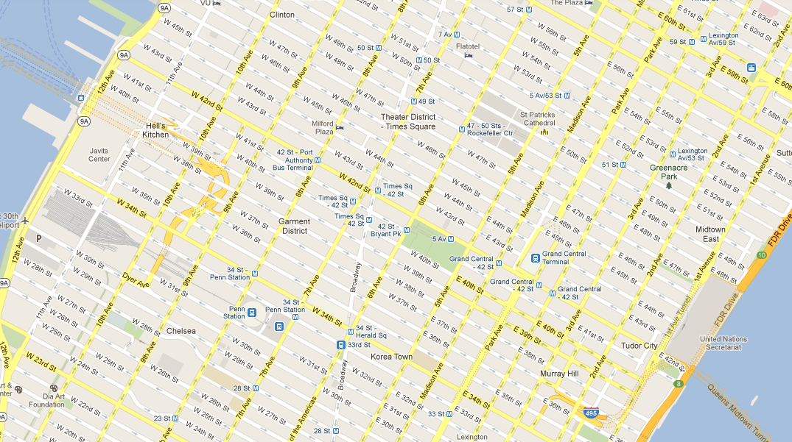

Each venue is defined in part by the mix of people who check-in there
Notes:
When you check-in somewhere you are effectively revealing to us a part of your mental map (at least the mental map you have at that point in time). When residents of a city check-in at a venue, they implicitly vote for that venue and tell us (at least on average) that this is place they consider to be good – be it to watch movies, do laundry, eat, exercise, catch a flight, go hiking.
A place with many check-ins is obviously a popular place, but in general not all places are popular with the same people and not always on the same days or at the same time of the day.
There are however people who have very similar patterns of activities. We thought it would be interesting to see if we could somehow capture these communities of people and their local footprints. We wanted to see if we could identify collections of nearby venues based on the mix of people likely to be found there. The idea was that somehow people’s activities could perhaps provide the basis for capturing a more organic view of neighborhoods.
.

Slide 24

We can aggregate these patterns to compute relationships between check-in venues.
Notes:
So we proceeded to look at each venue as defined by the mix of people who frequent that venue. Once you’ve done this , you can try to identify venues with a similar mix of people.
You can visualize this as a graph, where nearby venues that see very similar mixes of people are closely connected, as represented by the fat lines in this graph, whereas venues with dissimilar mixes of people are only weakly connected, or not connected at all.

Slide 25
These relationships can then be used to identify natural borders in the urban landscape.
Notes:
In mathematics, you have techniques known as spectral clustering techniques that you can adapt to do these types of calculations. I will not bore you with the details.
Using these graph clustering techniques we can identify natural (or organic) borders in the urban landscape given these relationships

Slide 26
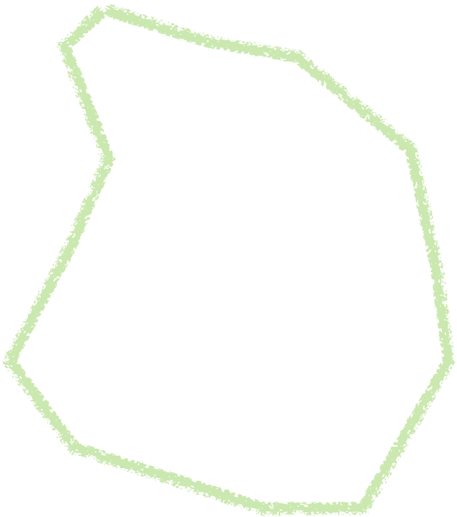

We call the discovered clusters “Livehoods” reflecting their dynamic character.
Livehood 2
Livehood 1
Notes:
Each livehood corresponds to a group of nearby venues that is frequented by a distinct mix of people.

Slide 27
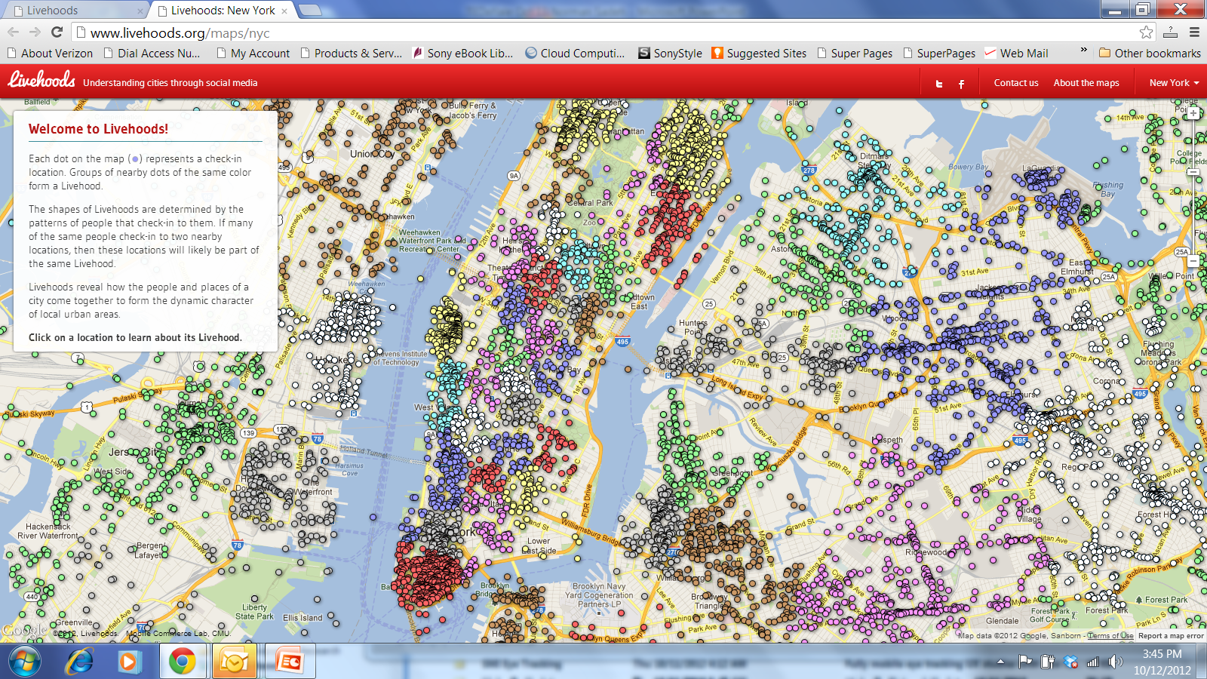
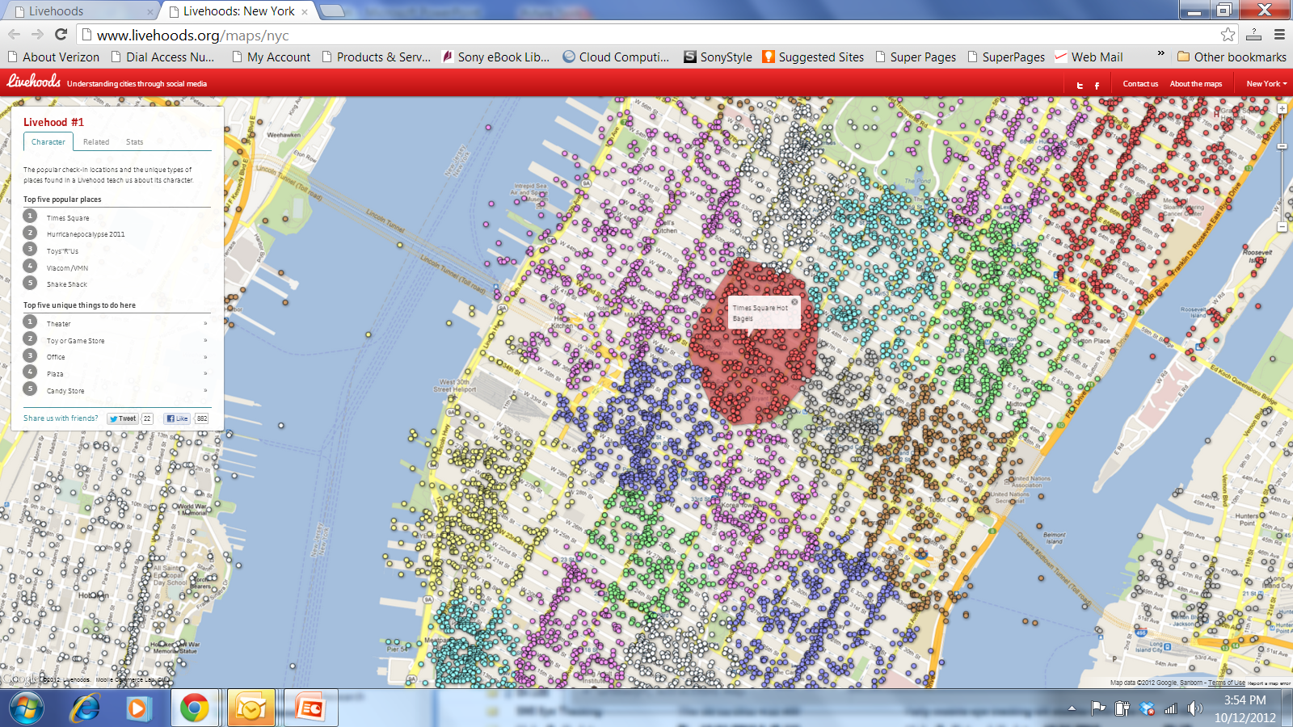
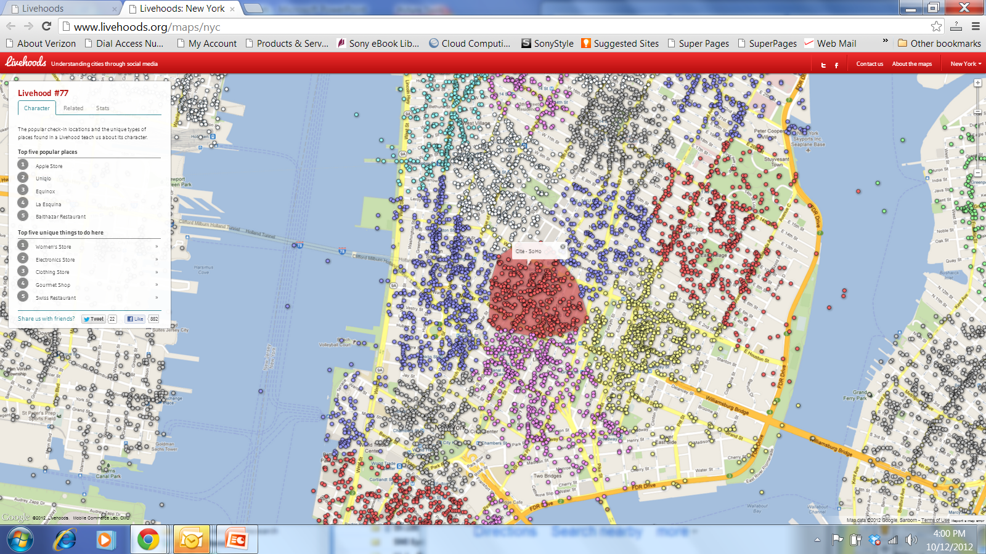
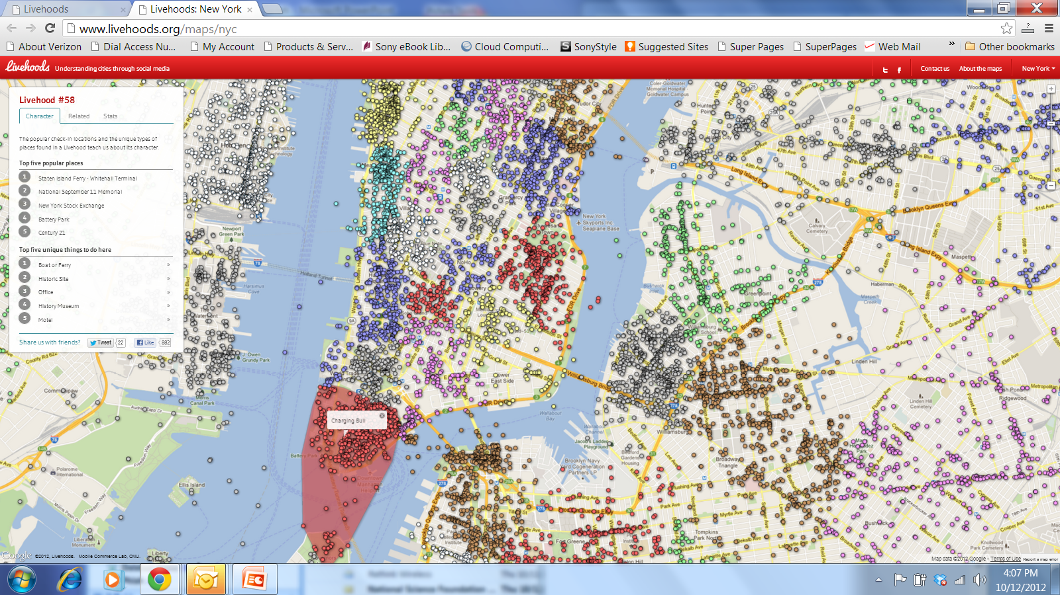
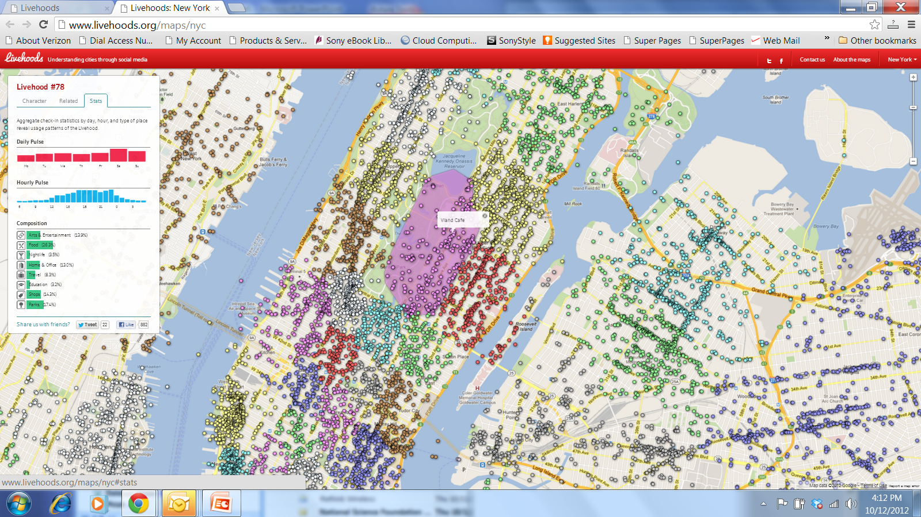
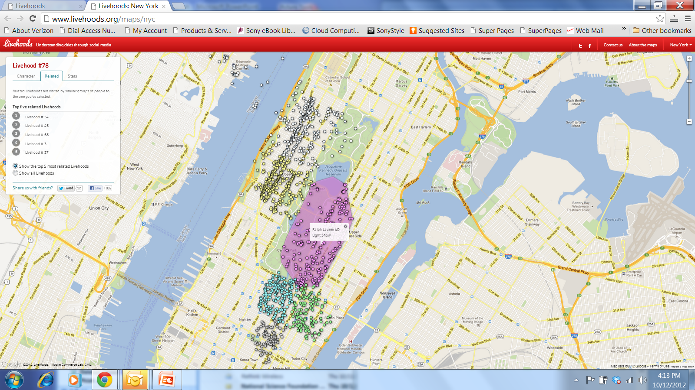
Notes:
So when you do this type of analysis, you can now draw maps that depict these livehoods. Here’s a map of Manhattan. You will easily recognize some well known areas such as Broadway, SoHo or the Financial district. Obviously, our algorithms didn’t know anything about these neighborhoods. They just rediscovered these areas in an organic manner, just through the analysis of check-ins at different venues.
Now, because Foursquare check-ins come with taxonomies of locations and with time annotations, we can also look at the daily and hourly pulses of different livehoods, the composition of venues in each livehoods and more.
For instance, I can also select a Livehood and look for other Livehoods that are most closely related to it based on the similarity between the mix of people checking in in these different Livehoods.

Slide 28
Examples of Projects
Determining promising outlet locations
Determining where to engage with customers
Urban redevelopment
Picking up trends in a city – year-over-year
Where to lease billboard space
…and many requests to work on more:
Tourism, crime, cross-border traffic, etc.

Slide 29
Exploring Temporal Dimension
Where people who attend a football game on Sunday go after the game is over
Where people who come to a mall on Saturday afternoon were in the morning
What are the neighborhoods most at risk if a given individual is found to be infected with a new strand of the flu virus
How the construction of a new highway in a given neighborhood might impact people’s activities
What people in a given area of town are most likely to be doing on a given day and at a given time
How you might want to modulate public bus schedules to accommodate shifting traffic demands over time

Slide 30
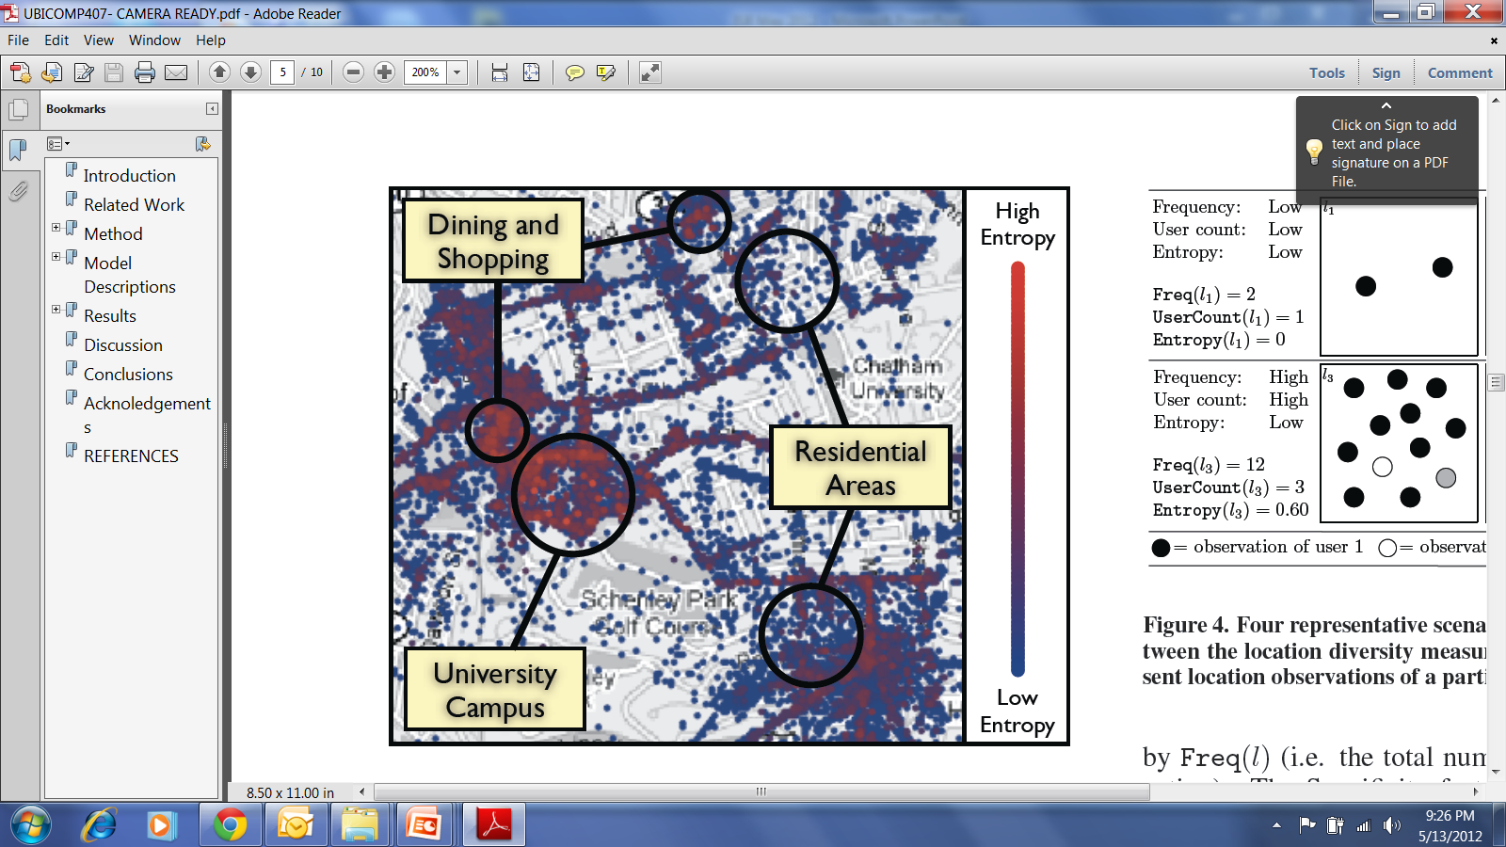
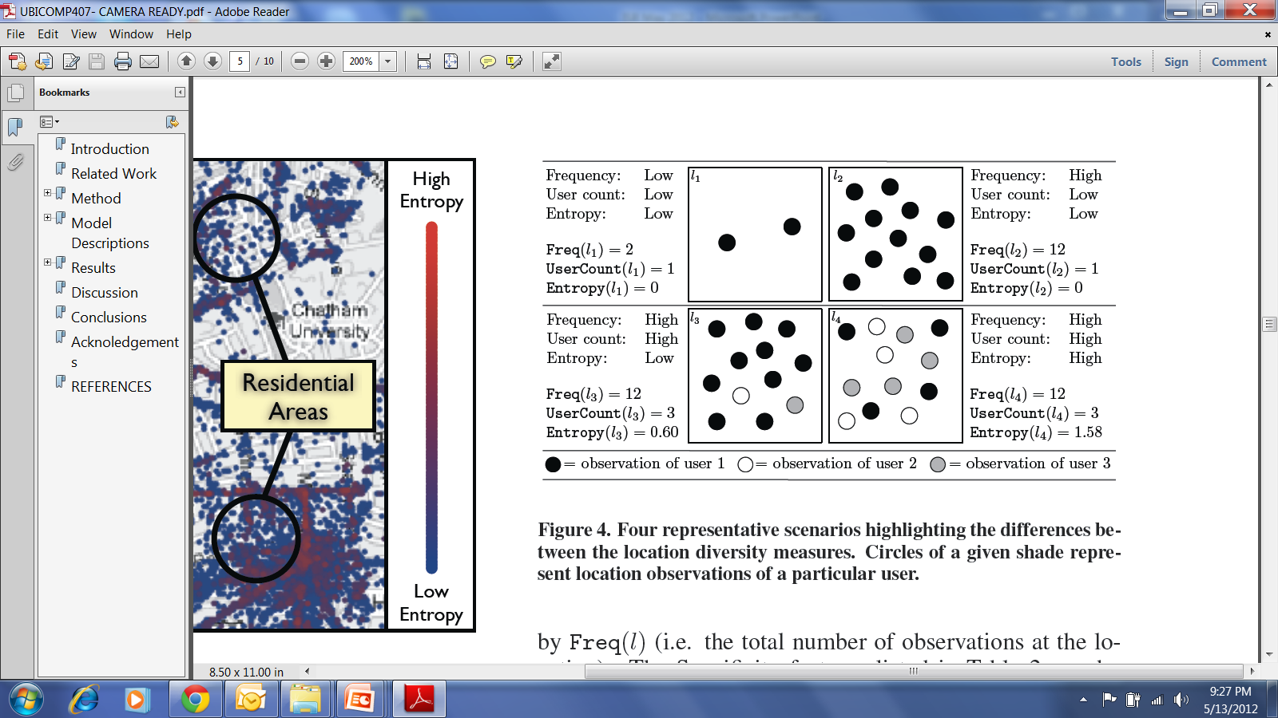
Example of Location Privacy Risks
Using location entropy and co-location to infer social relationships (likelihood of being Facebook friends)

Slide 31
References
Required:
These slides
Optional:
Understanding the HIPAA Privacy Rule: http://www.hhs.gov/ocr/privacy/hipaa/understanding/summary/
AOL 2006 search data leak incident: http://en.wikipedia.org/wiki/AOL_search_data_leak
J. Cranshaw, E. Toch, J. Hong, A. Kittur, N. Sadeh, “Bridging the gap between physical location and online social networks”, Ubicomp 2010 http://dl.acm.org/citation.cfm?id=1864380
The "Re-identification" of Governor William Weld's MedicalInformation: A Critical Re-examination of Health Data Identification Risks and Privacy Protections, Then and Now -http://papers.ssrn.com/sol3/papers.cfm?abstract_id=2076397
Inference Attacks on Location Tracks - http://research.microsoft.com/en-us/um/people/jckrumm/Publications%202007/inference%20attack%20refined02%20distribute.pdf

Slide 32
Q&A

